Slide 1

intranet mail system
SUBMITTED TO:
Dr. Namita Mittal
Department of Computer Engineering
MNIT Jaipur
Submitted by-
Praveen Kumar(2010UCP206)
Ram Bilash(2010UCP233)
Gopal Ram Dhaked(2010UCP222)

Slide 2
contents
OBJECTIVE
TOOLS AND TECHNOLOGY USED
FEATURES
DATABASE STRUCTURE
GUI INTEFACE
FUTURE SCOPE

Slide 3
OBJECTIVE
The main objective of “INTRANET MAIL SYSTEM” is to provide an essence of mailing simple and yet powerful interface.
This site is designed principally keeping a wide range of users in mind and hence the interface as well a the various procedures have been so designed that they can be used comfortably by all sorts of users.
The project has been designed to simulate the working of an actual Local host mail server.

Slide 4
TOOLS AND TECHNOLOGY USED
Utilization of following open source softwares to reduce the cost of whole system.
Java Servlet
Tomcat
Apache server
Mysql (Back End-For database)
HTML ( Front End)
Java Script

Slide 5
FEATURES
Sending Mail
An user logging into the site can sent mail to other user registered.
Add Contact
An user can add address of other users for future use.
Attechment
The sender can also attach files while composing message.
The user can use some additional features like directly reply from inbox.

Slide 6
Contd…
Functionality like edit address , select and deselect of messages also supports.
Log out can redirect to page their user can login again.

Slide 7

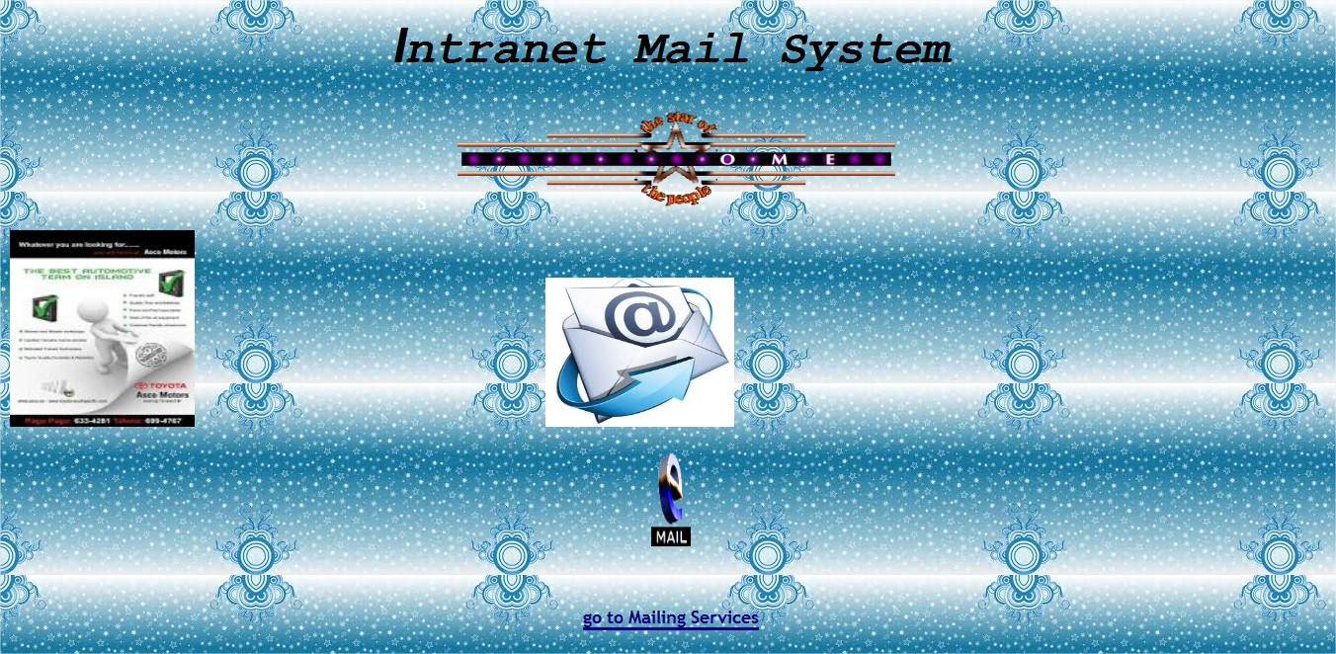
GUI INTERFACES
WELCOME PAGE

Slide 8
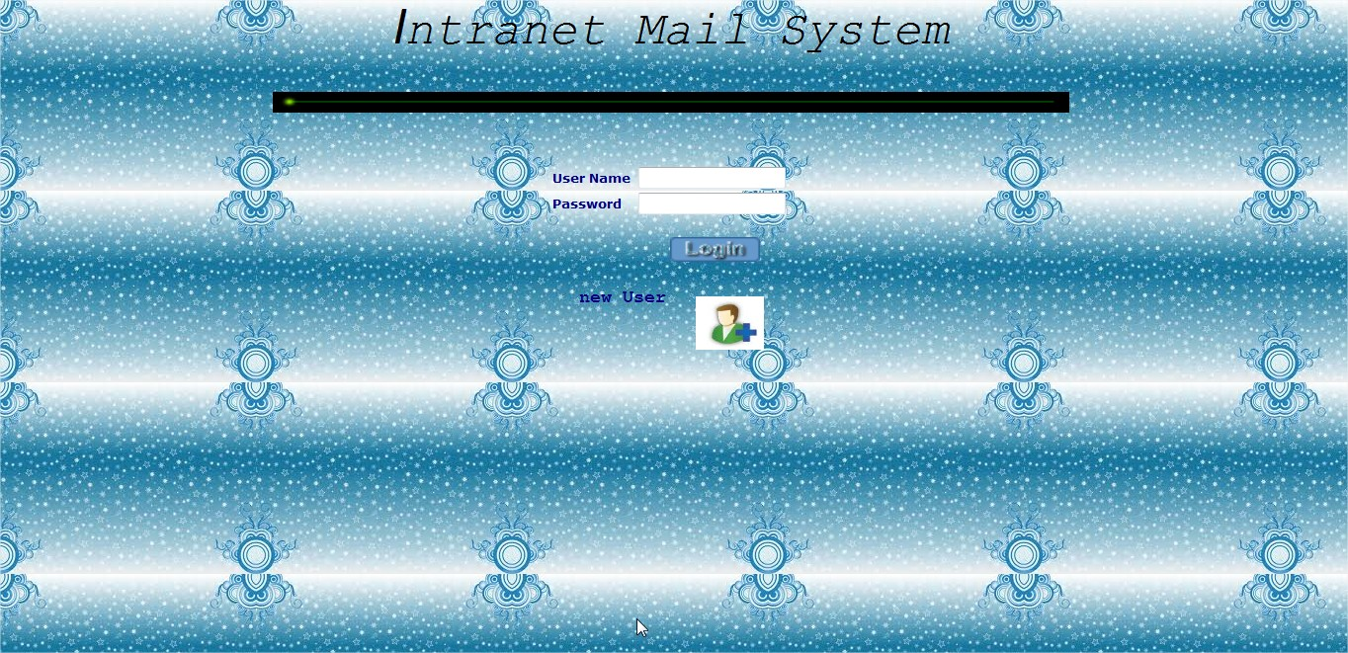
GUI INTERFACES
LOGIN PAGE

Slide 9
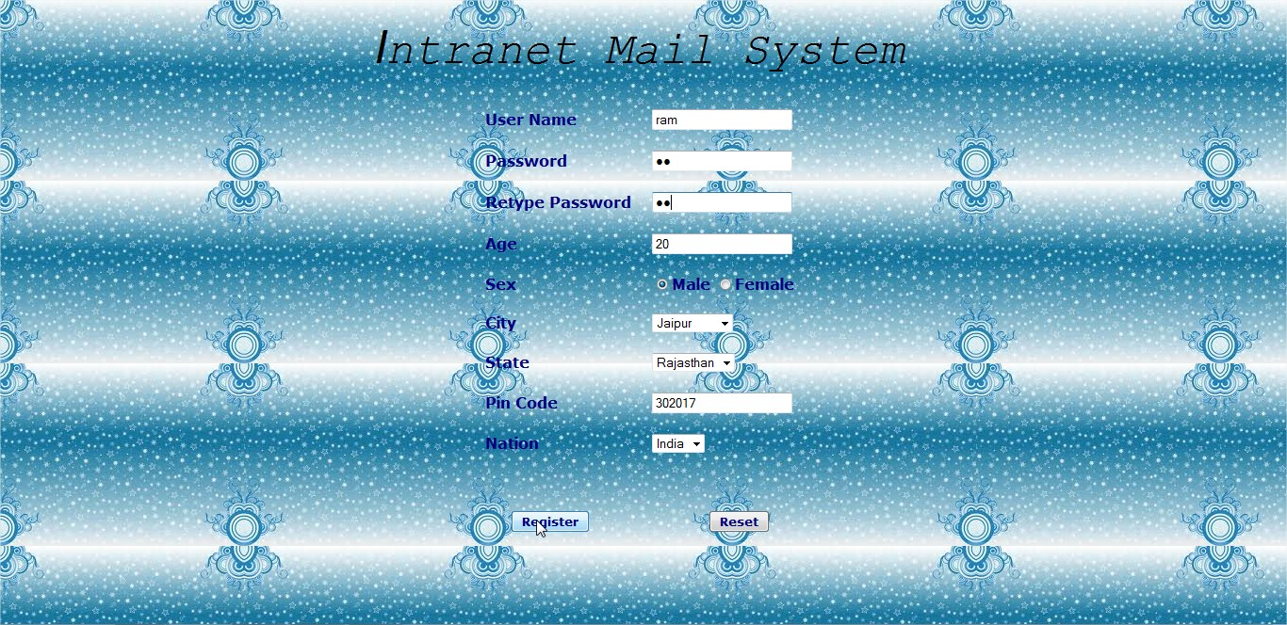
GUI INTERFACES
SIGN UP PAGE

Slide 10
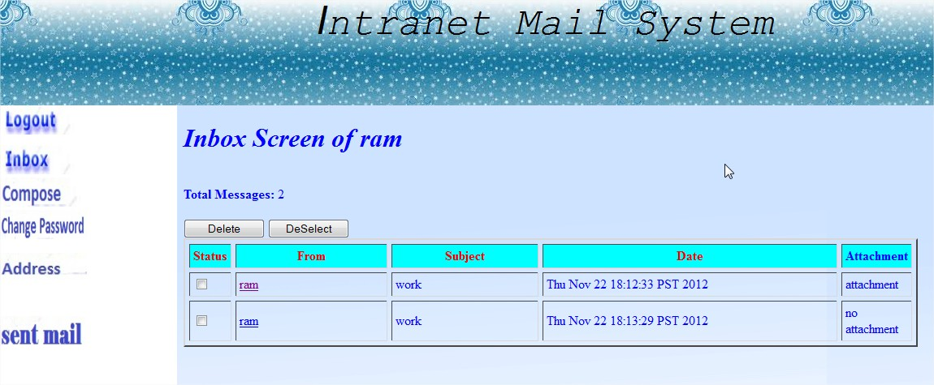
GUI INTERFACES
INBOX PAGE

Slide 11
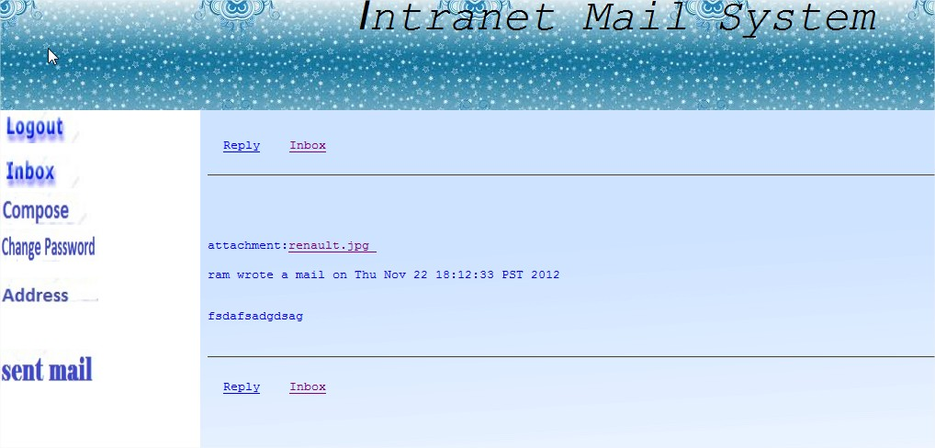
GUI INTERFACES
READ MESSAGE PAGE

Slide 12
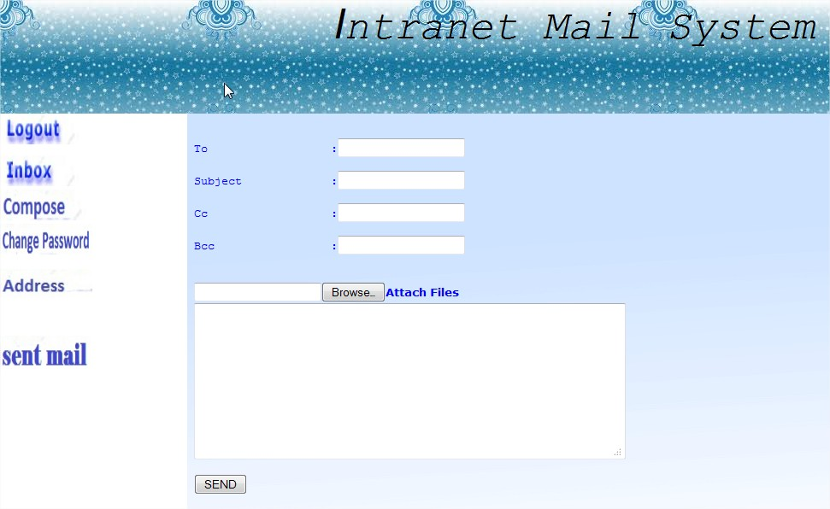
GUI INTERFACES
COMPOSE PAGE

Slide 13
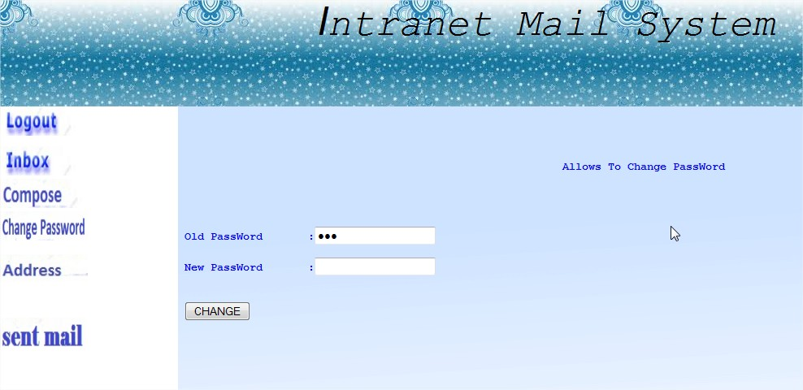
GUI INTERFACES
PASSWORD CHANGE PAGE

Slide 14
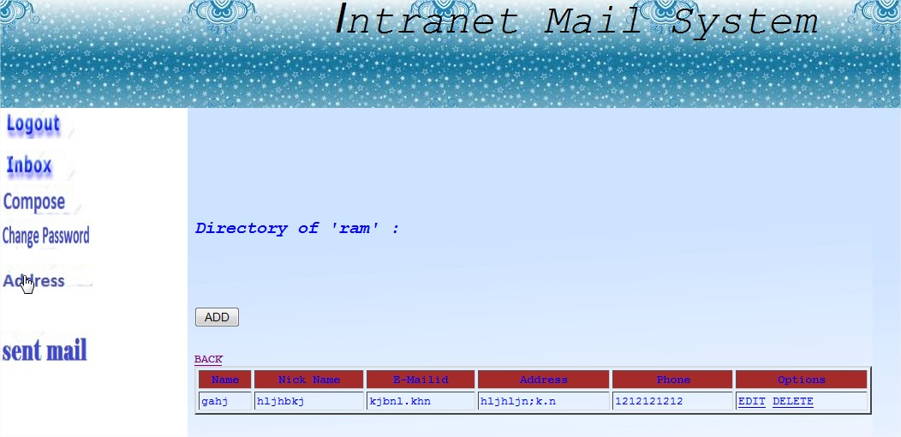
GUI INTERFACES
ADDRESS SCREEN PAGE

Slide 15
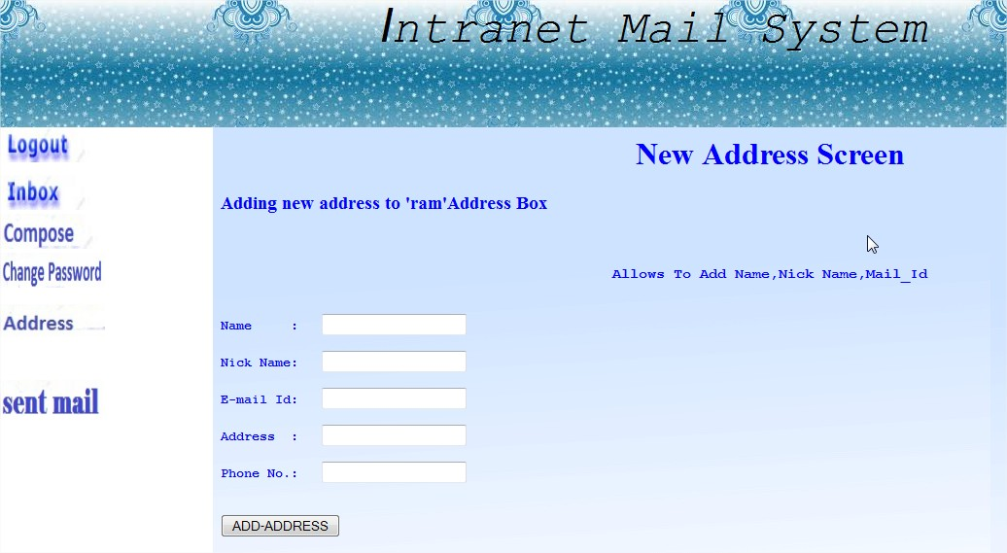
GUI INTERFACES
NEW ADDRESS SEREEN

Slide 16
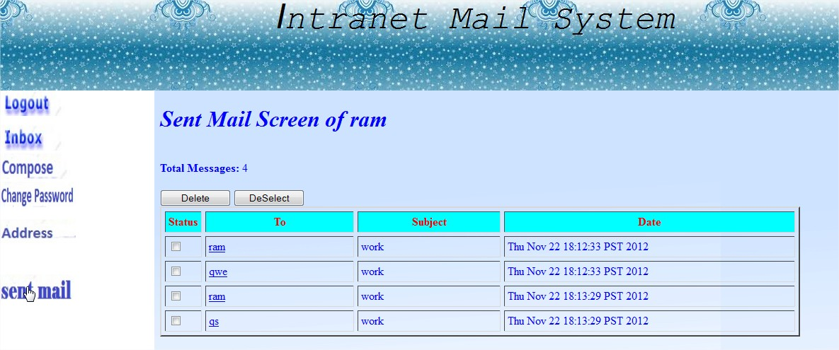
GUI INTERFACES
SENT MAIL PAGE

Slide 17
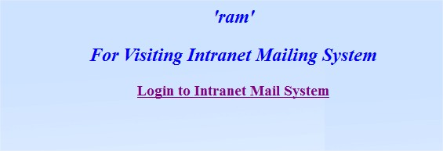
GUI INTERFACES
AFTER LOGOUT

Slide 18
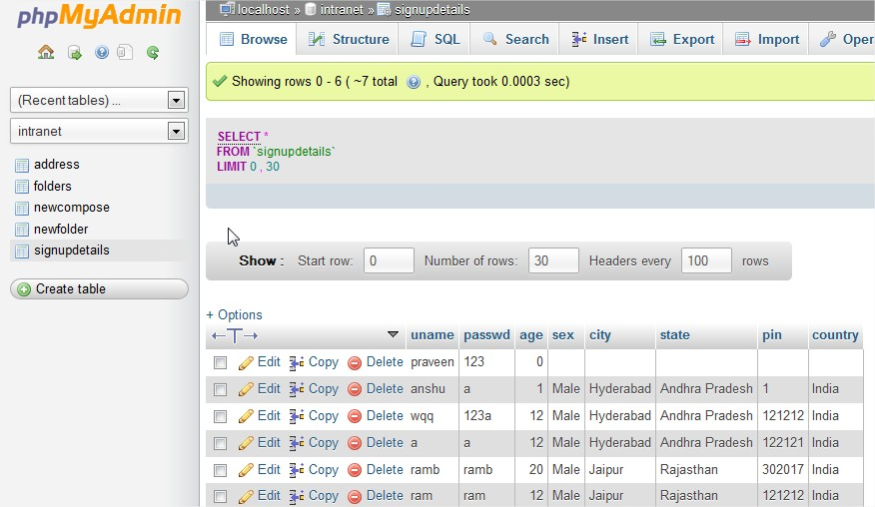
SIGNUP DETAILS TABLE

Slide 19
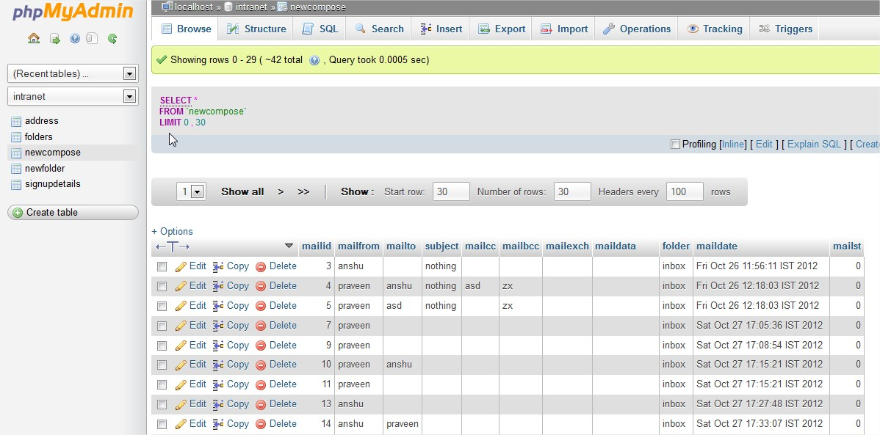
NEW COMPOSE TABLE

Slide 20
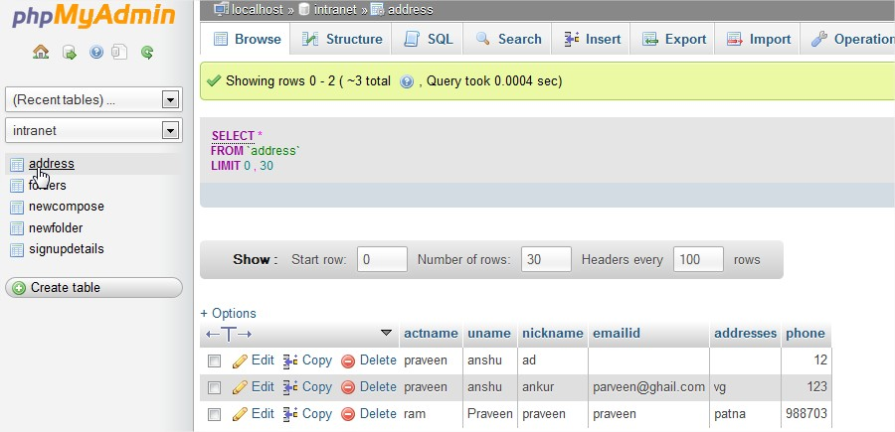
ADDRESS TABLE

Slide 21
FUTURE SCOPE
The project is just a prototype and has immense areas of development . The areas of development are as follows.
The web application can perform online chat application also.
The web application can also modified to maintain user’s profile so user can post something on it.

Slide 22


